Slide 1
Week 01
HUMAN-COMPUTER
INTERACTION
Usman Institute of Technology
FALL 2021
CS411 Human Computer Interaction
Introduction of Course

Slide 2

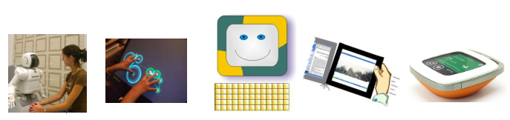

Slide 3
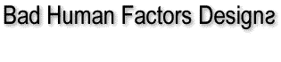

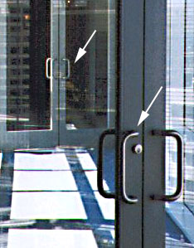
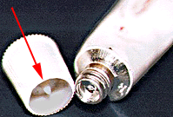
Trapped between the doors!
How do you open the toothpaste?

Slide 4
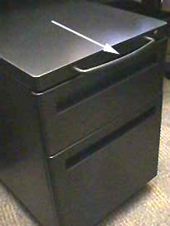
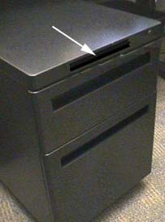
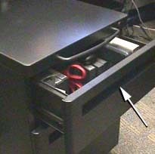
Opening the file drawer
Design Suggestion

Slide 5
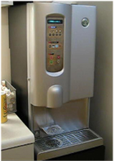
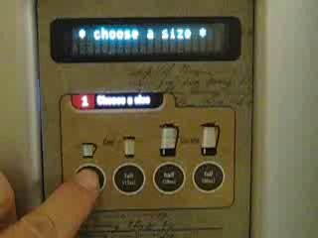
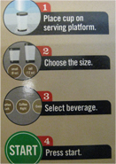
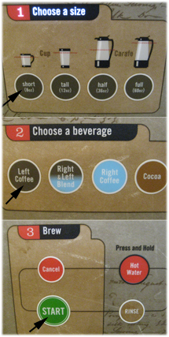
Coffee machine
Design suggestion

Slide 6
HUMAN-COMPUTER
INTERACTION
UIT
FALL 2021
Introduction
Instructor
Umair Khan
Lab Instructor
Fatima Shakeel

Slide 7
HUMAN-COMPUTER
INTERACTION
Agenda
Introductions
Course Administration
HCI Overview
Objectives

Slide 8



HUMAN-COMPUTER
INTERACTION
Course Information
Books
Human-Computer Interaction (3rd ed.) by Dix, Finlay, Abowd, Beale, Third Edition, 2009
Preece, J; Rogers, Y & Sharp, H Interaction Design, beyond human-computer interaction John Wiley (2002)
The Design of Everyday Things by Norman, 1990
Designing the User Interface, 5th Edition Ben Shneiderman and Catherine Plaisant, Addison Wesley,

Slide 9
HUMAN-COMPUTER
INTERACTION
UIT
FALL 2021
Introduction
Your turn
Interests
What you plan to do after graduation

Slide 10
HUMAN-COMPUTER
INTERACTION
UIT
FALL 2021
Course Information
Course Outlines
Grading
Assignment
Class Participation

Slide 11
HUMAN-COMPUTER
INTERACTION
UIT
FALL 2021
Advise
Learn from and use the past
Look to previous courses, courses elsewhere
Info on the web, …
Content, lectures, projects, …
Go further
Move beyond lectures & book
Further courses
Step into research

Slide 12
HUMAN-COMPUTER
INTERACTION
Human
Computer
Interaction

Slide 13

Human

Slide 14
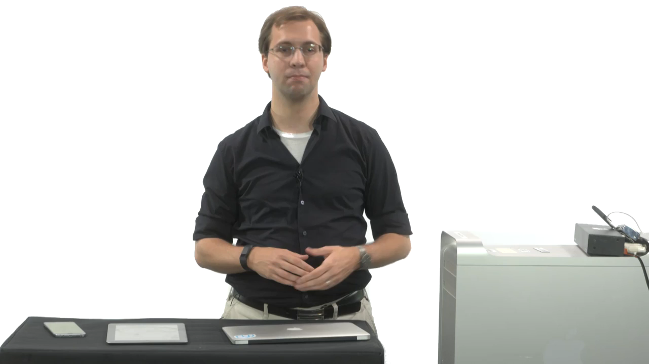
Computers

Slide 15

Interaction

Slide 16
HUMAN-COMPUTER
INTERACTION
UIT
FALL 2021
HCI – A Definition
“Human-Computer Interaction is a discipline concerned with the design, evaluation and implementation of interactive computing systems for human use and with the study of major phenomena surrounding them”
-ACM/IEEE

Slide 17
HUMAN-COMPUTER
INTERACTION
UIT
FALL 2021
HCI
What happens when a human and a
computer get together to perform a task
Task - write document, calculate budget, solve equation, learn about world, drive home,...
– Task might be play, learning,
communicating, …
– Not just desktop computers

Slide 18
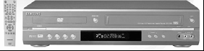
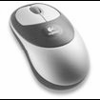
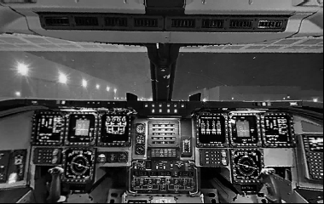
HUMAN-COMPUTER
INTERACTION
Interfaces in the World
Not just computers!
Mouse
Phone
Copier
Car
Plane cockpit
Airline reservation
Air traffic control

Slide 19

HUMAN-COMPUTER
INTERACTION
Course Aims
1. Consciousness raising
Make you aware of these issues
2. Design critic
Question bad design

Slide 20
HUMAN-COMPUTER
INTERACTION
Course Aims
3. Learn design process
Software interface and other artifacts
4. Improve your HCI design & Evaluation Skills
Go forth and do good work

Slide 21
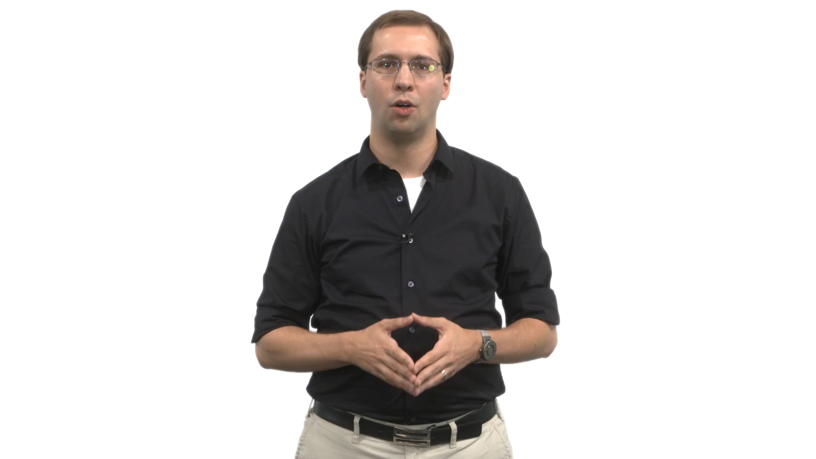
HCI and Big Picture

Slide 22
Human-Computer Interaction
HUMAN-COMPUTER
INTERACTION
User Experience
Usability
Interface
Interaction
Computer
Human

Slide 23
The Shopping Analogy
HUMAN-COMPUTER
INTERACTION
Types of experiences
Good or Bad
Every user is unique
Experiences are unique
Notes:
At a every point in life, human beings are experiencing. These experiences can be both good and bad.
Every person, every human being is different. In the same way that every person’s DNA is different, every person’s fingerprint is different, the retinal patterns on the eye are different, experiences are also different.
To explain the concept of the user experience, let’s take an example – shopping and buying, which is a very simple analogy:
We’ve all done shopping
When you visit a shop with a specific goal in mind
What happens: Can you find what you need? Is the interior and exterior nicely designed? Are the staff helpful and courteous? Is the atmosphere pleasant? etc.
What happens: If you can’t find what you want? Staff are not present, unhelpful or rude? You can’t find the pay counter? The atmosphere is unpleasant? The shop is dirty and untidy? The shop is not nicely designed? The shop is not open!!?
The result is an experience – either good or bad

Slide 24
User Experience – A Definition
HUMAN-COMPUTER
INTERACTION
The user experience is the holistic combination of everything that the user
Sees
Touches
Feels
Interacts with

Slide 25
Good and Bad Experiences
HUMAN-COMPUTER
INTERACTION
Good experience
Bad experience
Satisfaction
Happiness
Elation
Frustration
Resentment
Anger
Notes:
It’s all about TRUST in relationships.

Slide 26
Usability - Abstract-level Constituents
HUMAN-COMPUTER
INTERACTION
Ease of Use
(Could I use it?)
+
Usefulness
(Would I use it?)

Slide 27
Usability
HUMAN-COMPUTER
INTERACTION
Ensuring that interactive products are easy to learn, effective to user and enjoyable from the user’s perspective

Slide 28
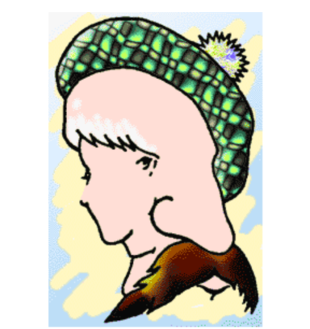
Perspective ?
HUMAN-COMPUTER
INTERACTION
People perceive the same item in different ways
What do you see in the Image ?

Slide 29
Usability & User Experience
HUMAN-COMPUTER
INTERACTION
User Experience Goals
Usability
Goals

Slide 30
Usability Goals
HUMAN-COMPUTER
INTERACTION
Effectiveness
Efficiency
Safety
Utility
Learnability
Memorablity

Slide 31
Effectiveness
HUMAN-COMPUTER
INTERACTION
How good the system is at doing what it is supposed to do
iDrive system being effective since it would perform all the tasks
The Alarm clock is effective in the way that it would play music in exactly the same way it is supposed to
Are these systems really effective ? Think again !!
Main goal of HCI is to evaluate things from the User’s perspective

Slide 32
Efficient
HUMAN-COMPUTER
INTERACTION
The way system supports its users in carrying out their tasks
Does the product help users sustain a high level of productivity?

Slide 33
Safety
HUMAN-COMPUTER
INTERACTION
Protecting the user from dangerous conditions and undesirable situation
Which of the Cases you think was the most unsafe ?
Plane
Nuclear reactor

Slide 34
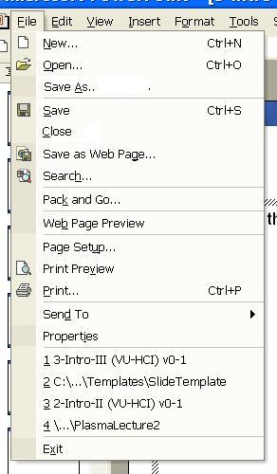
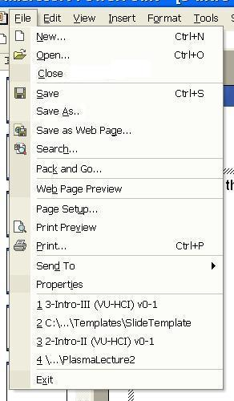
HUMAN-COMPUTER
INTERACTION
Safety
ok

Slide 35
Utility
HUMAN-COMPUTER
INTERACTION
System providing the right kind of functionality so that the
user can do what they want

Slide 36
Learnability
HUMAN-COMPUTER
INTERACTION
How easy a system is to learn to user

Slide 37
Memorability
HUMAN-COMPUTER
INTERACTION
How easy the system is to remember once learnt
Riding a bicycle

Slide 38
User Experience Goals
HUMAN-COMPUTER
INTERACTION
Satisfying
Enjoyable
Fun
Entertaining
Helpful
Motivating
Aesthetically Pleasing
Supportive to Creativity
Rewarding
Emotionally Fullfilling

Slide 39
HUMAN-COMPUTER
INTERACTION
Fun
Satisfying
Emotionally fullfilling
Efficient to use
enjoyable
Easy to remember
Effective to use
Rewarding
Usability
Goals
Easy to learn
Supportive of creativity
Entertaining
Safe to use
Have good utility
Aesthetically pleasing
helpful
Motivating

Slide 40
HUMAN-COMPUTER
INTERACTION
Famous Quotations
“It is easy to make things hard. It is hard to make things easy.” – Al Chapanis, 1982
“Learning to use a computer system is like learning to use a parachute – if a person fails on the first try, chances are he won’t try again.” – anonymous

Slide 41
HUMAN-COMPUTER
INTERACTION
Today’s Revelation
“Don’t Make me THINK, is the key to a usable product”

Slide 42
Quote of the Day – Terry Winograd
“HCI is the kind of discipline which is neither the study of humans nor the study of technology, but rather the bridging between the two. So you always have to have one eye open to the questions:
What can the technology do?
How can you build it ?
What are the possibilities?
And one eye open to the question
What are people doing and how would this fit in
What would they do with it ?
If you lose sight of either of those you fail to design well .. I think the challenge is to really keep knowledge of both the technology and the people playing off against each other in order to develop new things”

Slide 43
Engineers Belief
Engineers believe that since they made it, can use it, everyone can use it
“If WE can use it, YOU can use it. If you can’t, YOU must be STUPID”
“Users are stupid” – anonymous
“Users are dummies” – anonymous

Slide 44
But wait, computers weren’t made FOR engineers
I though it was made for normal human beings?!??!!

Slide 45
Success Criteria in the New Economy
Business success is all about managing relationships
Companies doing business on the Web are focusing on how to retain and extend relationships with customers

Slide 46
Success Criteria in the New Economy
Success depends upon the ability of a business to effectively and efficiently meet customer needs and goals
Business Success
∝
User Experience
Notes:
The success of a business is directly proportional to the user (customer) experience

Slide 47
Success Criteria in the New Economy
high
Factors providing competitive advantage
Business Strategy
User Experience
manifestation of business strategy
Technology
enabling factor for user experience & business strategy
low
Notes:
Putting everything in perspective, we can see how the user experience fits into the overall scheme of things.
Talk about business processes.

Slide 48
Common Problems in the New Economy
Scenario: A web site that is
Aesthetically beautiful
Technically perfect
Wonderful content
But users can’t find information!

Slide 49
Findability
Users can only find information 42% of the time
– Jared Spool

Slide 50
Findability
62% of web shoppers give up looking for the item they want to buy online
– Zona Research

Slide 51
Findability
50% of the potential sales from a site are lost because people cannot find the item they are looking for
– Forrester Research

Slide 52
The Result
40% of the users who do not return to a site do so because their first visit resulted in a negative experience
– Forrester Research

Slide 53
Software Maintenance Costs
80% of software lifecycle costs occur after the product is released, in the maintenance phase - of that work, 80 % is due to unmet or unforeseen user requirements; only 20 % is due to bugs or reliability problems.
- IEEE Software
Notes:
Usability has a very major impact on business.

Slide 54
Project Cost Estimation
Around 63% of software projects exceed their cost estimates. The top four reasons for this are:
Frequent requests for changes from users
Overlooked tasks
Users' lack of understanding of their own requirements
Insufficient user-analyst communication and understanding
- Communications of the ACM

Slide 55
Return on Investment (ROI)
 | Scenario A | Scenario B
Revenue Potential | $100m | $100m
User Experience | Good | Bad
Sales Lost | 0% | 50%
Revenue Lost | $0m | $50m
Actual Revenue | $100m | $50m
m - millions
Notes:
Translating these statistics into hard numbers drives home the significance of the user experience.
Consider the following scenarios for a particular company: observe the table

Slide 56
The End of Business As Usual
Business success is directly related to the customer experience
BOO.com, a $204m startup fails
– BBC News
Poor commercial web sites will kill 80% of Fortune 500 companies within a decade
- Jakob Nielsen

Slide 57

The Death Knell
The Death Knell
Products with a bad user experience deserve to
DIE !
Notes:
Picture the grim reaper.

Slide 58
What We Learnt Today …
HUMAN-COMPUTER
INTERACTION
Goals of HCI
Usability
User Experience
Success criteria in the new economy
Hopefully this has opened your eyes, mind, changed the way you think

Slide 59
HUMAN-COMPUTER
INTERACTION
Who Will…
Drive future technical breakthroughs?
Lead future paradigm shifts?
It just might be YOU!

Slide 60
Next Lecture
Interaction Design

